Slide 1
Assignment 4 State Space
Nusair Islam

Slide 2
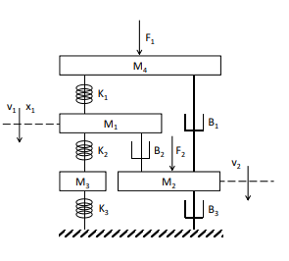
1. Compute A, B, C, D matrixes for the system
CONSTANTS:
M1 = 3
M2 = 7
M3 = 3
M4 = 7
k1 = 3
k2 = 6
k3 = 2
b1 = 10
b2 = 10
b3 = 9

Slide 3
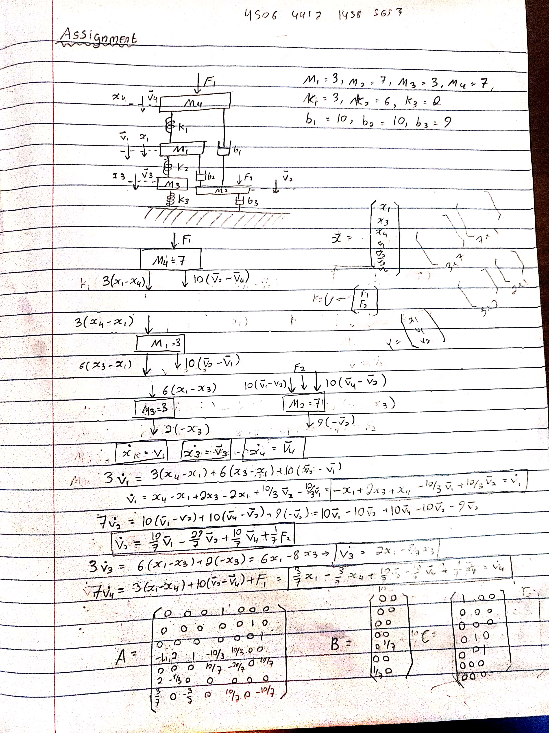
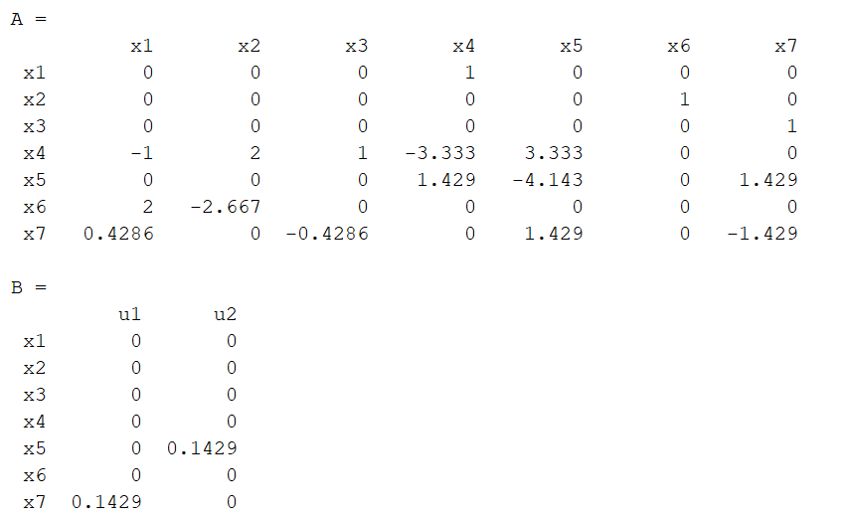
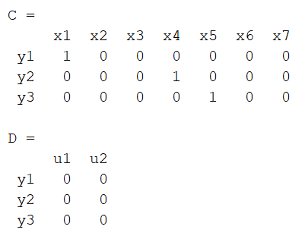
1. Compute A, B, C, D matrixes for the system
Work
Matrices

Slide 4
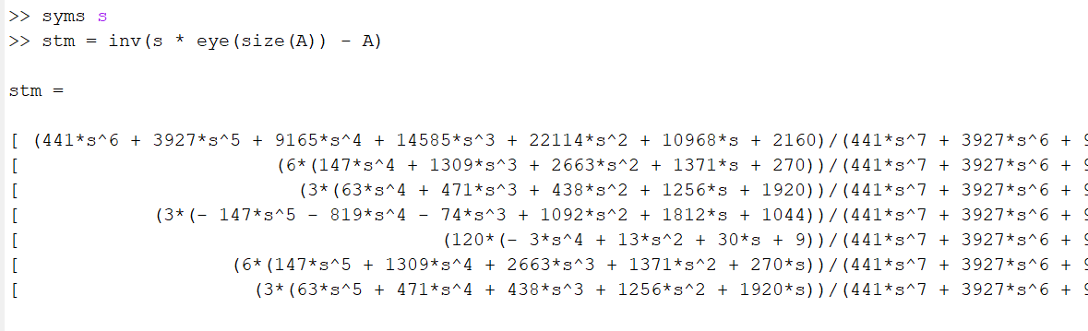
2. Use Matlab to compute the state transition matrix (STM) – How to get STM
Matlab script to create state transition Matrix (couldn’t fit full STM)
Φ(s) = Inverse([sI – A])

Slide 5
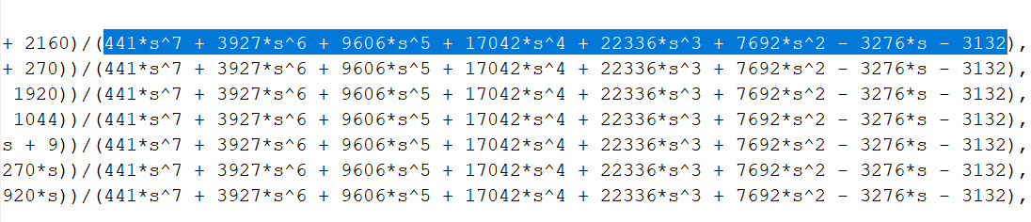
2. Use Matlab to compute the state transition matrix – Show STM has same roots as the State Space Model
STM had: 441*s^7 + 3927*s^6 + 9606*s^5 + 17042*s^4 + 22336*s^3 + 7692*s^2 - 3276*s – 3132
In the denominator

Slide 6
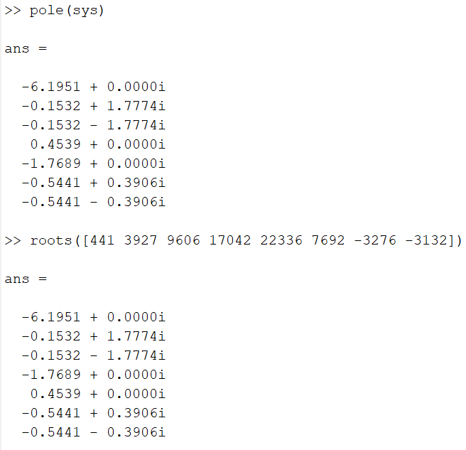
2. Use Matlab to compute the state transition matrix – Show STM has same roots as the State Space Model
By taking pole of State Space Model and
Roots of the denominator, we observe
That they are the same.

Slide 7
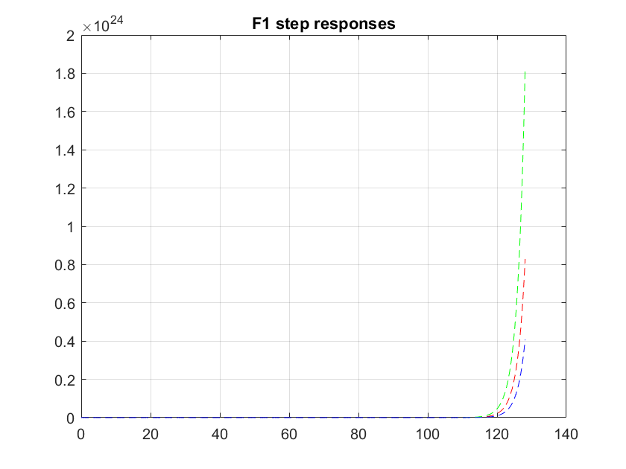
3. Plot the unit step response (F1 only) for all 3 outputs on the same graph

Slide 8
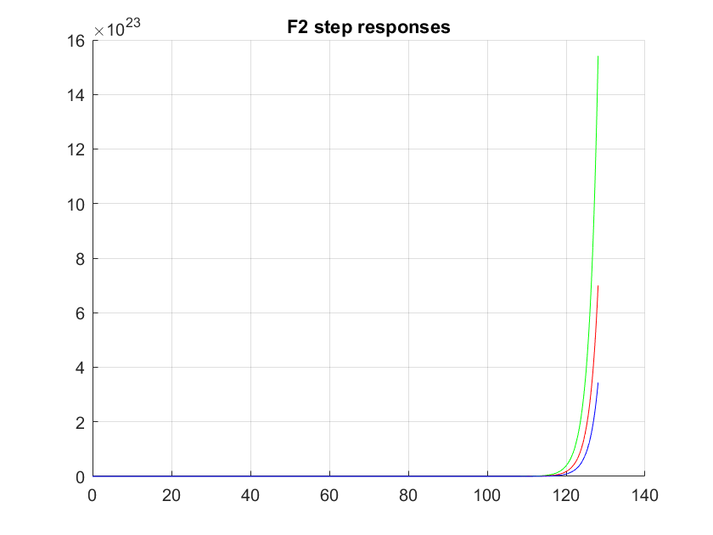
3. Plot the unit step response (F2 only) for all 3 outputs on the same graph

Slide 9
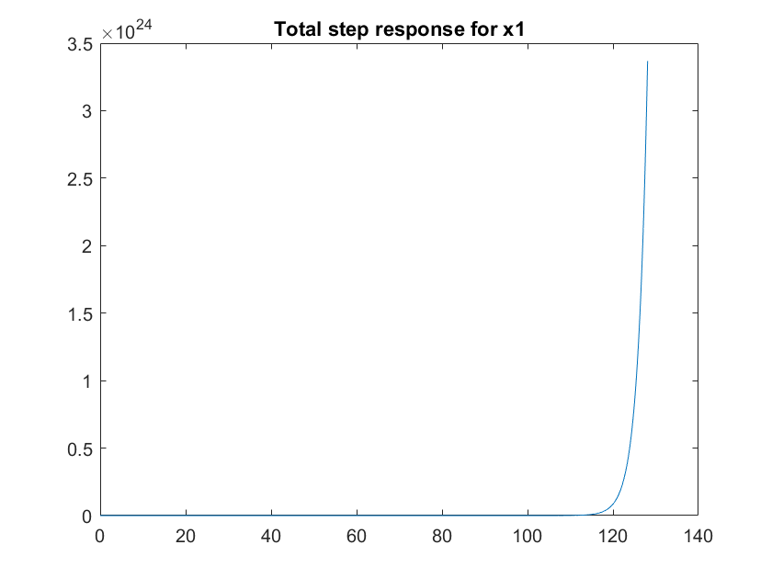
3. Plot total step response (F1 + F2) for x1 (first output)

